Slide 1

Decoding Fabric Licensing
Kristyna Ferris
Feel free to grab some swag & peanut butter cookies at the back!

Slide 2

About Me ~ Kristyna Ferris
Microsoft MVP, Data Platform & Fabric Solution Architect, P3 Adaptive Lexington Data Tech Group co-organizer Co-author on DataOnWheels
Blog - https://dataonwheels.wordpress.com/ LinkedIn - https://www.linkedin.com/in/kristyna-ferris-dataonwheels/
Twitter & Bluesky - @data_dragoness

Slide 3
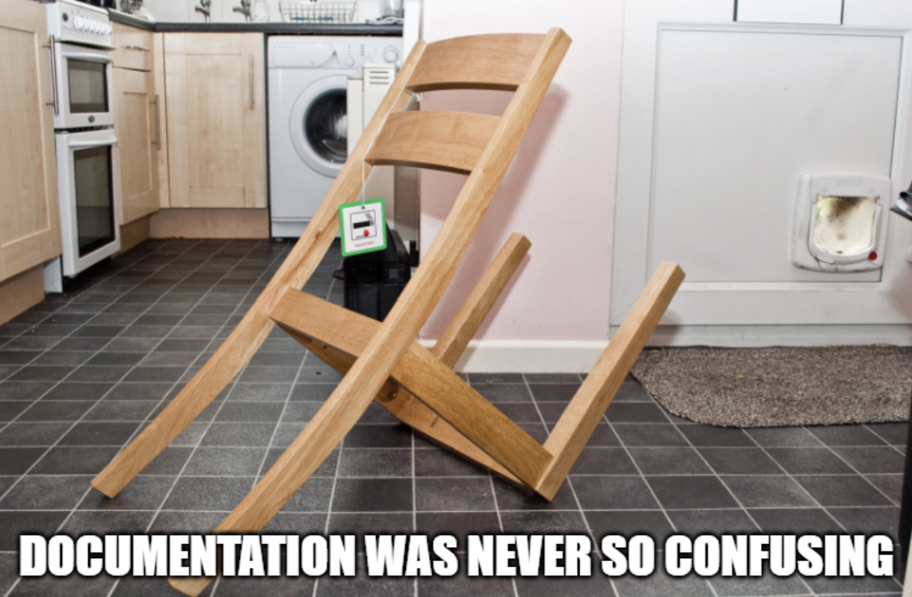
Fabric Licensing The IKEA Instructions of IT

Slide 4

Microsoft Fabric Licensing Key Concepts
Tenant - Microsoft Fabric is deployed to a Microsoft Entra tenant. Each tenant is tied to a specific Domain Name System (DNS) and other domains can be added to the tenant.
Capacity - Resides within a Fabric tenant. Each capacity that sits under a tenant is a distinct pool of resources allocated to Fabric. Size of the capacity determines the amount of computation power available. You can have multiple capacities per tenant. Each tenant has a default shared capacity that does not cost anything, but it cannot run Fabric items and items are not sharable. Shared capacity runs on a server shared with other tenants. Dedicated capacity runs on a server that only contains your tenant’s data (FSKUs).
Workspaces
Resides within capacities. Used as containers for Microsoft Fabric items. Each user has a personal workspace called “My Workspace”. More workspaces can be created to enable collaboration. You can have multiple workspaces in a capacity.
Notes:
Microsoft Fabric concepts - Microsoft Fabric | Microsoft Learn Your Ultimate Guide to Microsoft Fabric Pricing and Licensing
Power BI Premium Per User - Power BI | Microsoft Learn

Slide 5
Microsoft Fabric Licensing Key Concepts
Stock Keeping Units (SKU) – Provides a set of Fabric resources for your organization.
Individual User Licensing – Licenses that are applied to individuals such as Power BI Pro and Power BI Premium Per User. These two licenses are purchased through Microsoft 365 portal.
Pay-As-You-Go Pricing – Fabric SKUs (FSKUs) that are purchased as needed. Can be set up to automatically scale up and down based on need and can be easily paused to save money when not in use. Ideal for work loads that do not need to run all the time and have highly variable consumption.
Reserved Pricing – FSKUs that are purchased at least a year in advance for a 40% pricing discount. Ideal for work loads that require continuous up time.
Notes:
Microsoft Fabric concepts - Microsoft Fabric | Microsoft Learn Your Ultimate Guide to Microsoft Fabric Pricing and Licensing
Power BI Premium Per User - Power BI | Microsoft Learn

Slide 6









The House
The House - Tenant
Living Room - Shared Capacity
Kitchen, Garage - Dedicated Capacity
My Chair - Personal Workspace
Fabric Workspace
Couch - Pro Workspace
Fancy Recliner - PPU Workspace

Slide 7


Licenses are the Key
More sharing options
More storage options
More automation options
And….more money

Slide 8

The Couch Upgrade
Power BI Pro
Cost - $14/month/user
Purchase Location - M365, is also included with an E5 license
Enables
Publishing Power BI reports to a shared workspace
Access to shared capacity workspaces that are not PPU workspaces
Notes:
Microsoft Fabric concepts - Microsoft Fabric | Microsoft Learn

Slide 9
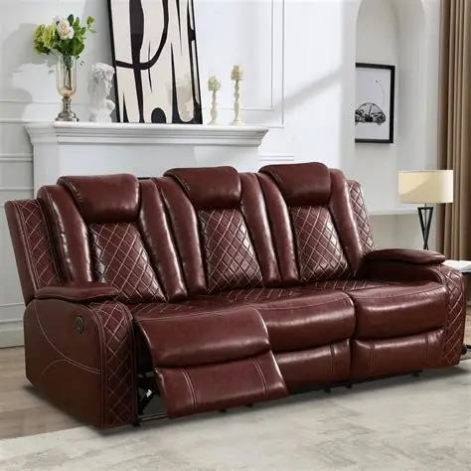
The Fancy Recliner
Premium Per User
Cost - $24/month/user
Purchase Location - M365
Enables
Publishing Power BI reports to a shared workspace
Access to shared capacity workspaces
Larger model sizes
More frequent refreshes
XMLA endpoint connectivity
Advanced dataflow features
Incremental refresh
Notes:
Microsoft Fabric concepts - Microsoft Fabric | Microsoft Learn

Slide 10
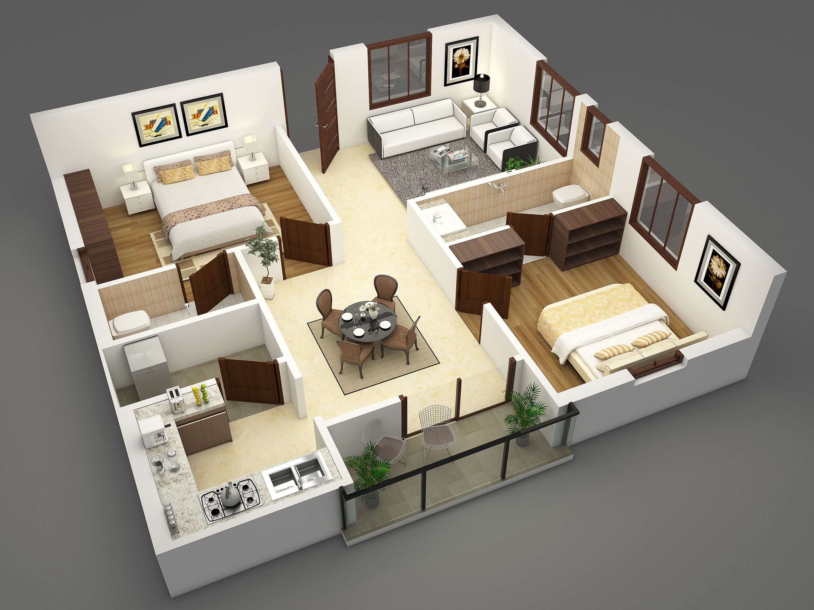
The Rest of the House
Fabric Capacity
Cost – depends on SKU and reserved pricing/pay-as-you-go
Purchase Location – Azure portal.
Requires an Azure subscription and resource group.
Enables
>= F64 SKU enables Copilot, free license viewing, and AI skills
Managed private endpoints
On-demand resizing, pause, and resume capacity
Trusted workspace access
Fabric artifacts
Notes:
Microsoft Fabric concepts - Microsoft Fabric | Microsoft Learn

Slide 11


So how much for the house?
Pay-as-you-go
Reservation

Slide 12
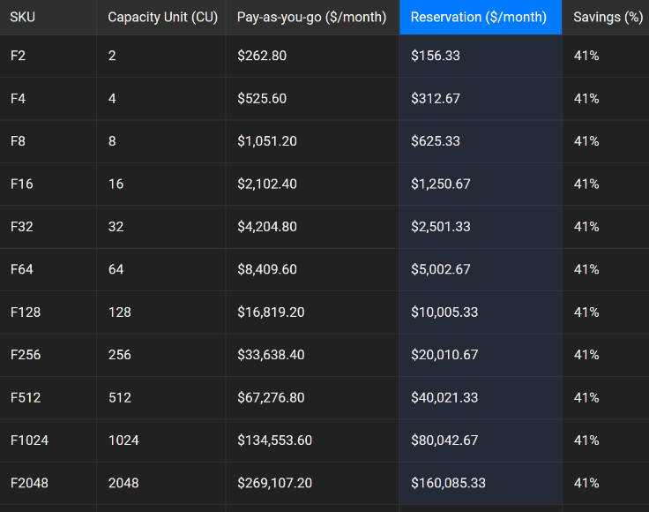
Fabric Capacity Pricing
Pay-as-you-go
Reservation
Allows for pausing and auto-scaling capacity
Can be combined with a reservation to allow for auto-scaling when needed
Significantly more expensive than a reservation, but may end up cheaper if not turned on all the time
Breaks even with reserved at < 14 hours a day
41% discount
Does not scale up/down depending on usage
Reservation is cheaper because you sign a year long contract for a set number of SKUs
These SKUs can be split into multiple capacities if desired
Notes:
Microsoft Fabric - Pricing | Microsoft Azure
Breakeven points:
F64 = 358 pro licenses = 209 ppu licenses
730 hours FSKU reserved (a month) = 434 hours FSKU pay-as-you-go (18 days)
If you only need capacity for <14 hours a day, pay-as you-go is the best option

Slide 13

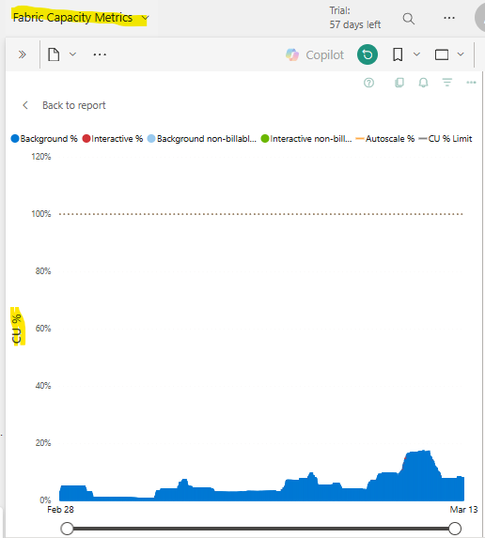
Picking out a Fabric SKU
Use a Fabric Trial! The trial is 60 days of free F64 usage
Only use a maximum 80% of capacity
If you have multiple developers, min recommended SKU is F8
If you have multiple data sources to ingest, min recommended SKU is F16
If you have a lot of free users, consider a F64 for free viewer licensing (discussed more in upcoming slides)
You can have a different capacity for each environment (development, testing, and production workspaces running separately)
Notes:
Install the Microsoft Fabric capacity metrics app - Microsoft Fabric | Microsoft Learn
F8 allows for multiple spark sessions at a time for notebooks. This allows more than one developer to be working in a notebook at once.
F16 has proven to be a good SKU for ingesting multiple data sources into Fabric using a metadata driven approach.
F64 unlocks more capabilities, but those are not unlocked with a F64 reservation, only with a F64 capacity.

Slide 14

How Do Reservations Work?
Reservation Scenario 1 F64 split into multiple capacities
Annual contract with Microsoft for a 41% discount on F SKUs. Can be paid monthly or upfront. These SKUs can be split into multiple capacities or all used within one capacity. You pay for all the SKUs even if they are not assigned to a capacity, so it is best to use them all.
You can get cancel, exchange, or refund reservations with certain limitations
Capacity 1 – F16
Capacity 3 – F32
Capacity 2 – F16
Reservation Scenario 2 F64 one capacity
Capacity 1 – F64*
* These workspaces get the benefits of an F64 capacity (Copilot, free license viewing, and AI skills)
Notes:
https://learn.microsoft.com/en-us/azure/cost-management-billing/reservations/fabric-capacity#cancel-exchange-or-refund-reservations

Slide 15

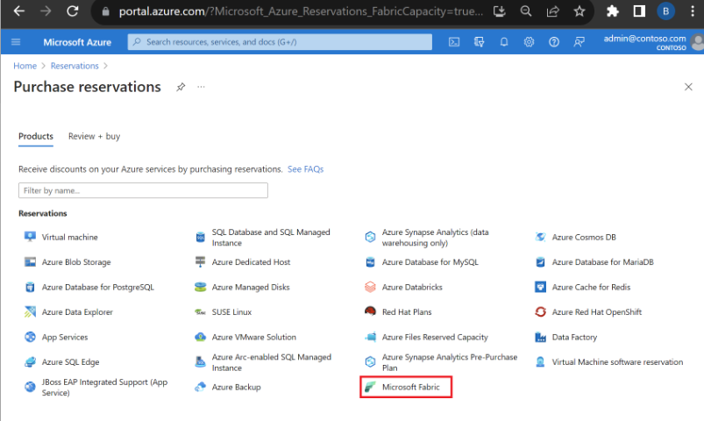
How-To Purchase Capacity Reservation
portal.azure.com > Reservations > Microsoft Fabric
Prerequisites
Azure Subscription (method for paying)
Azure Resource Group (tool for grouping your Azure resources)
Must have owner role or reservation purchaser role on an Azure subscription
Notes:
Save costs with Microsoft Fabric Capacity reservations - Microsoft Cost Management | Microsoft Learn
For Enterprise subscriptions, the Reserved Instances policy option must be enabled in the Azure portal. If the setting is disabled, you must be an EA Admin to enable it.
Direct Enterprise customers can update the Reserved Instances policy settings in the Azure portal. Navigate to the Policies menu to change settings.
For the Cloud Solution Provider (CSP) program, only the admin agents or sales agents can purchase Fabric capacity reservations.
https://learn.microsoft.com/en-us/azure/cost-management-billing/reservations/fabric-capacity#cancel-exchange-or-refund-reservations

Slide 16

What’s the Right Option for You?

Slide 17

What’s the Right Option for You?

Slide 18








Licensing Scenario Personas & Workspace Types
Data Engineers
Power BI Developers
Report Viewers
Responsibilities:
Create Fabric artifacts (lakehouses, warehouses, notebooks, data pipelines, etc.)
Responsibilities:
Create Power BI semantic models
Create Power BI reports
** Publish reports to shared workspaces
Responsibilities:
*** Utilize Power BI reports to answer business questions
Fabric Capacity Workspace
Personal Workspace
Premium Per User Workspace
Shared Workspace (no capacity)
** Requires either a pro or ppu license
*** Requires a pro license if in a shared workspace, ppu license if in a ppu workspace, and no license if in a F64 capacity workspace
Notes:
Microsoft Fabric concepts - Microsoft Fabric | Microsoft Learn Pro workspaces allow for 10 GB size datasets, only 8 refreshes a day.
PPU workspaces allow for 100 GB size datasets, 48 refreshes a day, advanced dataflow features, deployment pipelines, xmla connectivity, page refresh, incremental refresh.

Slide 19

Licensing Example 1 No ETL, Small User Base
Assumptions
0 Fabric Data Engineers
Engineering is handled outside Fabric
2 Power BI Developers
50 Report Viewers
X 0 = $0
X 2 x $14/pro license = $ 28
X 50 x $14/pro license = $700
Total Monthly Estimate: $728
Total Annual Estimate: $8,736
+ External Engineering Costs
Notes:
Microsoft Fabric concepts - Microsoft Fabric | Microsoft Learn
Power BI Premium Per User - Power BI | Microsoft Learn
Pro workspaces allow for 10 GB size datasets, only 8 refreshes a day. Breaks even with F64 at 358 users.
PPU workspaces allow for 100 GB size datasets, 48 refreshes a day, advanced dataflow features, deployment pipelines, xmla connectivity, page refresh, incremental refresh. Breaks even with F64 at 209 users.

Slide 20


Licensing Example 2 No ETL, Small User Base, PPU Workspaces Needed
Assumptions
0 Fabric Data Engineers
Engineering is handled outside Fabric
2 Power BI Developers
50 Report Viewers
X 0 = $0
X 2 x $24/ppu license = $48
X 50 x $24/ppu license = $1,200
Total Monthly Estimate: $1,248
Total Annual Estimate: $14,976
+ External Engineering Costs
Notes:
Microsoft Fabric concepts - Microsoft Fabric | Microsoft Learn
Power BI Premium Per User - Power BI | Microsoft Learn
Pro workspaces allow for 10 GB size datasets, only 8 refreshes a day. Breaks even with F64 at 358 users.
PPU workspaces allow for 100 GB size datasets, 48 refreshes a day, advanced dataflow features, deployment pipelines, xmla connectivity, page refresh, incremental refresh. Breaks even with F64 at 209 users.

Slide 21
Licensing Example 3 No ETL, Large User Base
Assumptions
0 Fabric Data Engineers
Engineering is handled outside Fabric
5 Power BI Developers
∞ Report Viewers
Reserved F64 pricing
X 0 = $0
X 5 x $14/pro license = $70
F64 = $5,000
X ∞ x $0 viewer = $0
Total Monthly Estimate: $5,070
Total Annual Estimate: $60,840
+ External Engineering Costs
Notes:
Microsoft Fabric concepts - Microsoft Fabric | Microsoft Learn
Power BI Premium Per User - Power BI | Microsoft Learn
Pro workspaces allow for 10 GB size datasets, only 8 refreshes a day. Breaks even with F64 at 358 users.
PPU workspaces allow for 100 GB size datasets, 48 refreshes a day, advanced dataflow features, deployment pipelines, xmla connectivity, page refresh, incremental refresh. Breaks even with F64 at 209 users.

Slide 22
Licensing Example 4 Small ETL, Small User Base
Assumptions
2 Fabric Data Engineers
Going with F16 for the estimate
Using reserved pricing
2 Power BI Developers
50 Report Viewers
F16 = $1,250
X 2 x $14/pro license = $28
X 50 x $14/pro license = $700
Total Monthly Estimate: $1,978
Total Annual Estimate: $23,736
Notes:
Microsoft Fabric concepts - Microsoft Fabric | Microsoft Learn
Power BI Premium Per User - Power BI | Microsoft Learn
Pro workspaces allow for 10 GB size datasets, only 8 refreshes a day.
PPU workspaces allow for 100 GB size datasets, 48 refreshes a day, advanced dataflow features, deployment pipelines, xmla connectivity, page refresh, incremental refresh.
Until F64, all viewers need a pro license to view

Slide 23
Licensing Example 5 Larger ETL, Small User Base
Assumptions
2 Fabric Data Engineers
Going with F32 for the estimate
Using reserved pricing
2 Power BI Developers
50 Report Viewers
F32 = $2,501
X 2 x $14/pro license = $28
X 50 x $10/pro license = $700
Total Monthly Estimate: $3,229
Total Annual Estimate: $38,748
Notes:
Microsoft Fabric concepts - Microsoft Fabric | Microsoft Learn
Power BI Premium Per User - Power BI | Microsoft Learn
Pro workspaces allow for 10 GB size datasets, only 8 refreshes a day.
PPU workspaces allow for 100 GB size datasets, 48 refreshes a day, advanced dataflow features, deployment pipelines, xmla connectivity, page refresh, incremental refresh.
Until F64, all viewers need a pro license to view

Slide 24
Licensing Example 6 Larger ETL, Large User Base
Assumptions
10 Fabric Data Engineers
Going with F64 for the estimate
Using reserved pricing
5 Power BI Developers
∞ Report Viewers
F64 = $5,000
X 5 x $14/pro license = $70
X ∞ x $0 viewer license = $0
Total Monthly Estimate: $5,070
Total Annual Estimate: $60,840
Notes:
Microsoft Fabric concepts - Microsoft Fabric | Microsoft Learn
Power BI Premium Per User - Power BI | Microsoft Learn
Pro workspaces allow for 10 GB size datasets, only 8 refreshes a day.
PPU workspaces allow for 100 GB size datasets, 48 refreshes a day, advanced dataflow features, deployment pipelines, xmla connectivity, page refresh, incremental refresh.
Until F64, all viewers need a pro license to view

Slide 25

Questions?

Slide 26

Don’t forget to connect, thanks for listening!
https://dataonwheels.wordpress.com/
kristyna@dataonwheels.com
@data_dragoness
GitHub

